Slide 1
Design Digitaler Schaltkreise
Place and route 2
Prof. Ivan Peric ivan.peric@kit.edu
Richard Leys richard.leys@kit.edu

Slide 2
Lecture Goal
Understand the basics of Timing Configuration
Understand the concept of Clock Synthesis
See last routing and design completion steps

Slide 3
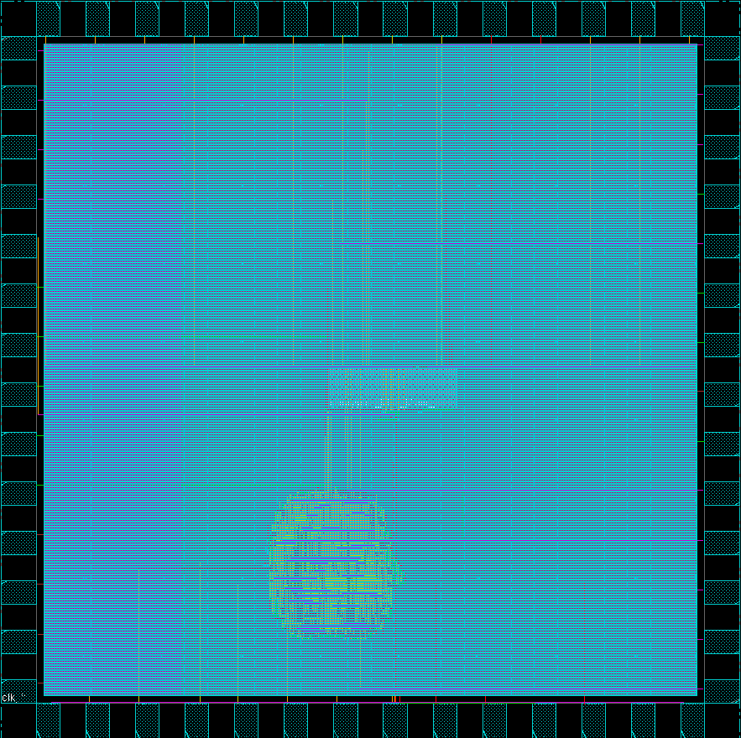
Where are we?
Floorplaning is done and set
Input Outputs are set
Power structures have been planned
Standard Cells are placed
Remains:
Distribute the clock
Route the design
Respect Design Rules for manufacturing
Keep timing within acceptable margins
Output design data for DRC/LVS and production

Slide 4
Reminder: Setup/Hold
Clock Relation:
Setup: Time available before the next clock
Hold: Time “not available” after a clock cycle
Slow / Fast:
Setup: Issue if we are too slow, not enough available time
Hold: Issue if we are too fast
Slow (setup) and Fast (hold) Corners required!!!
Implementation Fixes:
Setup:
Faster Logic -> Low VT Cells?
Pipelining: Divide the logic in more clock periods
Change Clock: Start next previous Flop-Flip later: Useful skew
Hold:
Slow the logic: Add delay Buffers
Change Clock: Start previous Flip-Flop clock later
Post-Implementation Fixes:
Setup: Slow the clock…
Hold: Nothing to be done ☹
Pipeline Stage
Delay: Clock Skew

Slide 5
Timing Setup: MMMC
Multi-Mode Multi-Corner
Mode: Different constraints
Corners: Different parameter/delay settings for different conditions
Voltages
Temperature
Best Case, Worst Case
Views: Modes + Corners
Slow Corners: Fix Setup
Fast Corners: Fix Hold
Modes
*
Corners
Test, Functional, Power save etc…
Best, Worst etc…
views

Slide 6
Timing Setup: Process & On Chip Variation
OnCHip Variation and Process/Temperature Variation
X% difference: Process Variation
X% difference: On-Chip Variation
Wafer
ASICS
ASIC

Slide 7
Timing Setup: On Chip Variation
For smaller technology nodes (<65nm) On-Chip Variation (OCV) become more and more dominant:
Two adjacent transistors on the die are different.
The smaller the technology, the more disparate it gets.
OCV also affects RC extraction for routing lines
OCV adds up as an extraction corner
Worsens the runtimes
Setup challenges: Technology specific, not always easy to have correct values to setup the tool with.
Difficulty for us: very much process-related, we are not process experts
In an industry context: don’t forget about it!

Slide 8
Timing Fixes during implementation
In Cadence tools, the optDesign command is used to reclaim timing after each phase:
Before Clock Tree Synthesis
Before Routing
After Routing
Timing Fixes are done for Setup and Hold separately
Fixes may alter manufacturing rules (DRC)
DRC may alter timing:
Always re-optimise the design along the implementation flow
Ignore this right now:
No Specific pattern:
See what the tool does and re-call design optimisation with different options to fix alterations
Runtimes go higher, not a good idea for the lab work as well

Slide 9
Clock Tree Synthesis (CTS)
Clock is a special net
Per-Clock domain:
1 Clock Source
Many Sinks
Goal: Clock available at all flip-flops at the same time
Clock net is very demanding:
Toggles a lot: Power consumption
Can toggle fast: Signal Integrity aggressor
Long wires: Difficult to drive and balance
Sinks
clk
root

Slide 10
CTS: Clock Skew
Clock (see below) skew influences setup and hold slack
Clock arrives at Launch and Capture ports
Positive and Negative Skew are possible
Launch
Capture
Tlaunch
Tcapture
Skew = Tcapture - Tlaunch
Positive: Leaves time for setup
Negative: Removes time for setup

Slide 11
CTS: Semantics
Latency is used to describe the time to reach the sinks
Skew is defined in: Local and Global categories
Local for related flip-flops
Global for unrelated flip-flops
clk
Local Skew
Global Skew
Latency

Slide 12
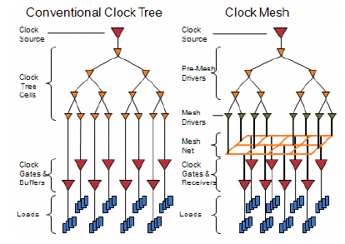
CTS: Achieving Zero-Skew
There are two types of clock routing:
Clock Tree: The commonly used path
Clock mesh: A grid for the clock
Better Skew, but higher resource usage
Main Goal: No skew
All flip-flops get the clock at the same time
Zero-Skew clock tree algorithms are available and researched
Not the focus here
At Lower technology nodes:
On-Chip Variation influence increases (OCV)
Clock meshes seem to have a better tolerance to OCV
Rule: Understand what the tool can do, and the advantages for the specific technology and chip size
http://www.design-reuse.com/articles/21019/clock-mesh-benefits-analysis.html

Slide 13
CTS: Useful Skew example
Feature example: The tool can try to use positive/negative skew to improve setup or hold timing
Use with precaution, first try to meet timing with no fancy feature
Launch
Capture
Tlaunch
Tcapture
Inserted delay

Slide 14
Clock Tree and IO Timing
Clock Tree Latency usually shows up in timing violations for Input / Output Paths
Reminder:
Input: Reserve time from clock period for signal to come to us
Output: Reserve time from clock periode for signal to get to others
Clock Tree Depth: Latency
Latency adds time to clock: Good for input; bad for output
Output delay constraint
Latency
Remaining time
out
clk

Slide 15
CTS: Report example
clk

Slide 16
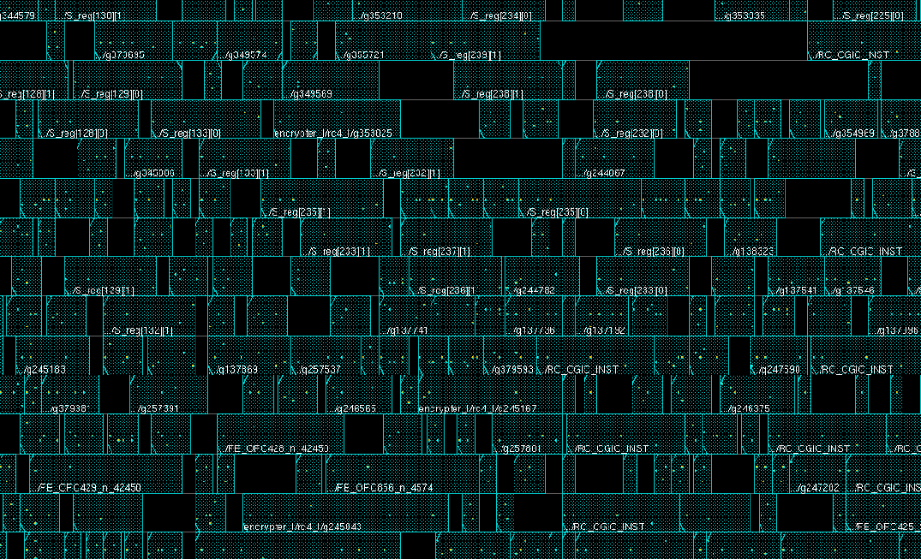
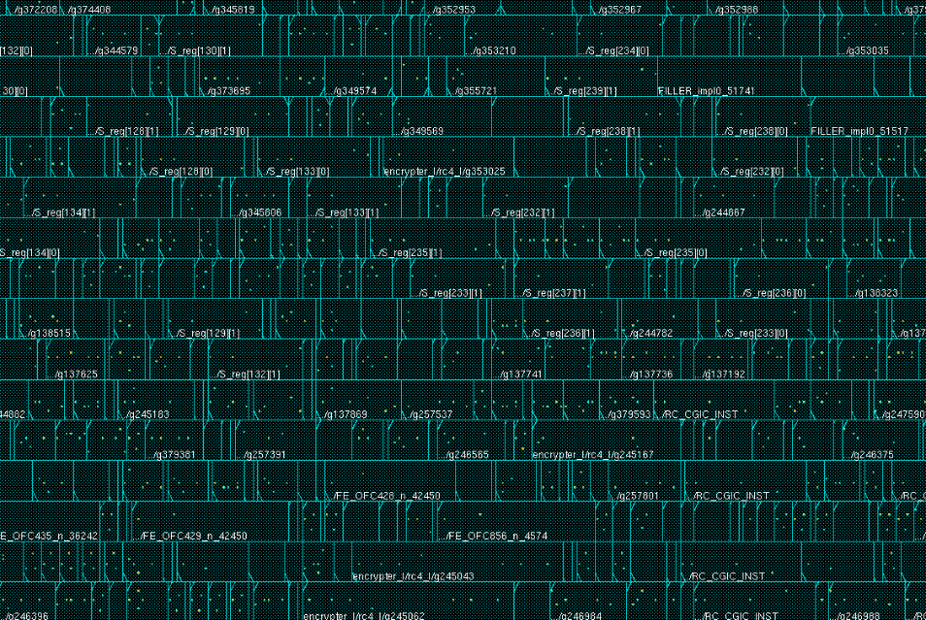
Routing: Global Overview
Finish All data paths routing with accurate extraction
Fill the core area blanks with filler cells (see technology documentation for cell names)
Perform Global and detail routing
Extraction optimises RC and signal integrity quality7
Timing is analysed and routing adapted in consequence
Blanks
FILLERS
No Blanks

Slide 17
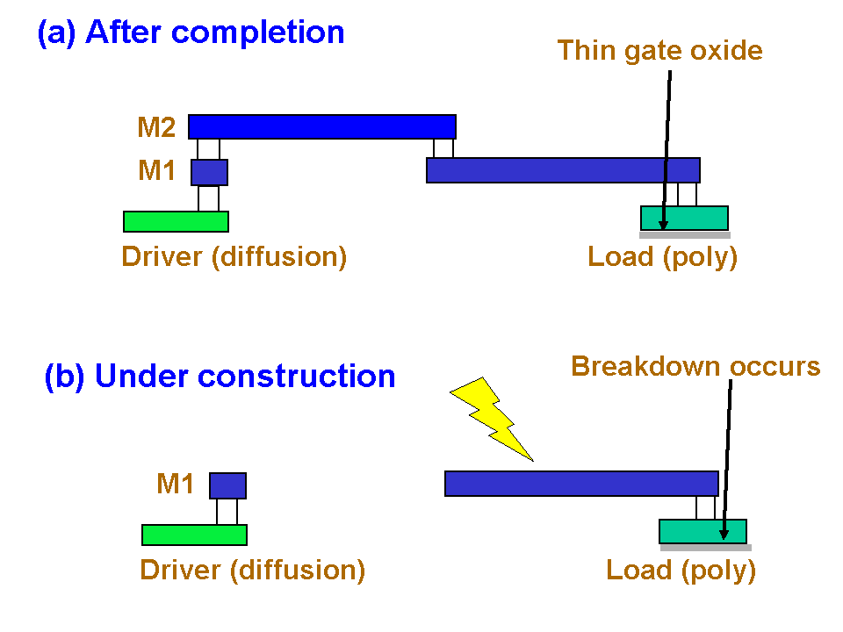
Routing: Antenna Fixing
Antenna is a risk during manufacturing process
A discharge may occur through routed floating nets to transistor gates
Charges collect on metal during etching
IC would not be working if it happens
Fixes:
Antenna Cells are inserted to ensure discharge occurs into substrate
Router can add « Layer Bridge »
Routing might also leverage antenna fixing, so the router may route based on timing and Antenna constraints
(wikipedia: Antenna Effect)

Slide 18
Routing: Antenna Fixing
Metal 2
Metal 1
Poly
Bridge Fix
Metal 2 Build after Metal 1
Metal 2 is Short
Antenna FIX
(wikipedia: Antenna Effect)

Slide 19
Prepare for Manufacturing
Final Steps before manufacturing:
Verify and fix DRC
Retime/Refix design
Perform Metal Filling to fix density DRC
Reverify/Retime/Refix design
Write out a GDS file
Perform Layout versus Schematic
Refix design
Good to go!

Slide 20
Metal Filling
Filling: Add Dummy metal in empty areas
Very Important to ensure metal planarity:
During Metal Polishing, if the metal density is low, the isolation oxide may get polished more than the metal
The layer would not be planar anymore and risk damaging the next layer deposition and VIA constrution
Adds parasitic capacitance -> timing is rechecked
Not always done in the tool, other tools can be used
Sometimes the Foundry access service provider does metal filling (ex: Multi Project Wafer funs)
Fillers
Tracks

Slide 21
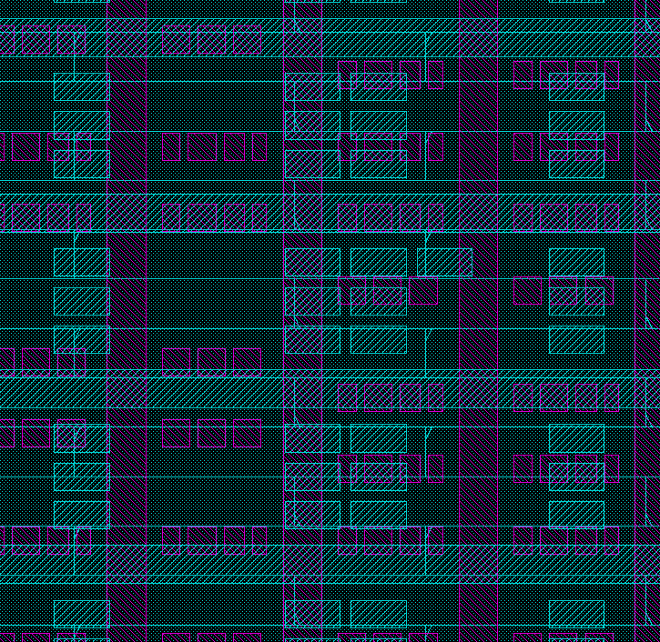
Metal Filling
Density fillers

Slide 22
End Slide

